Slide 1
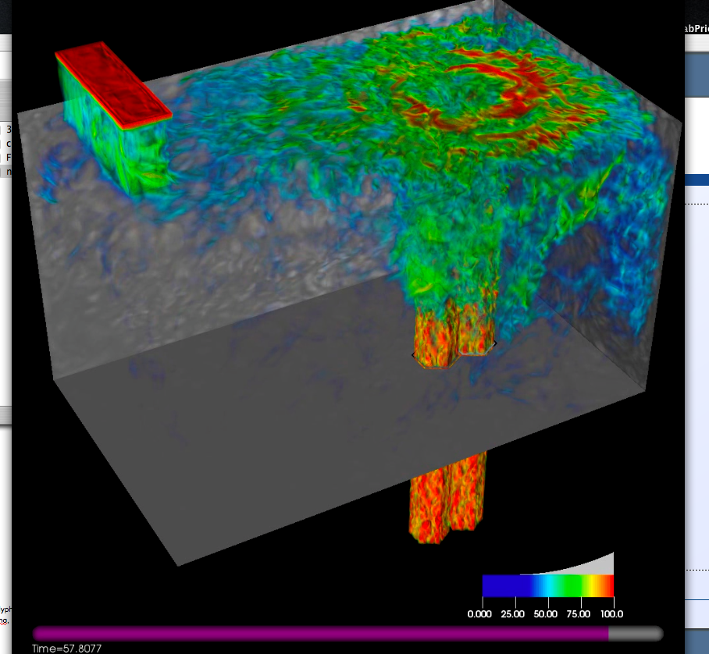
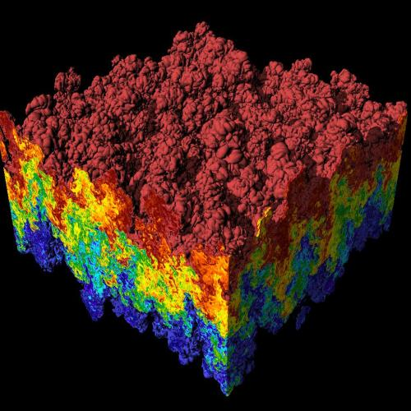
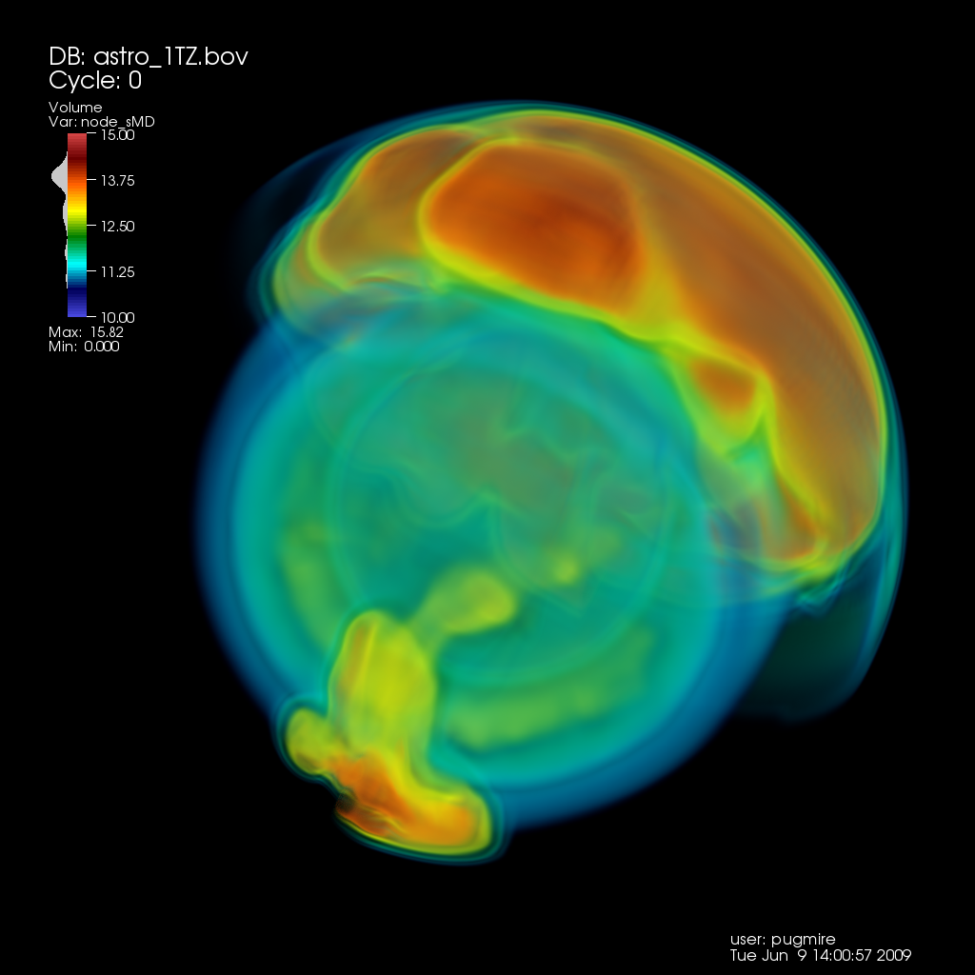
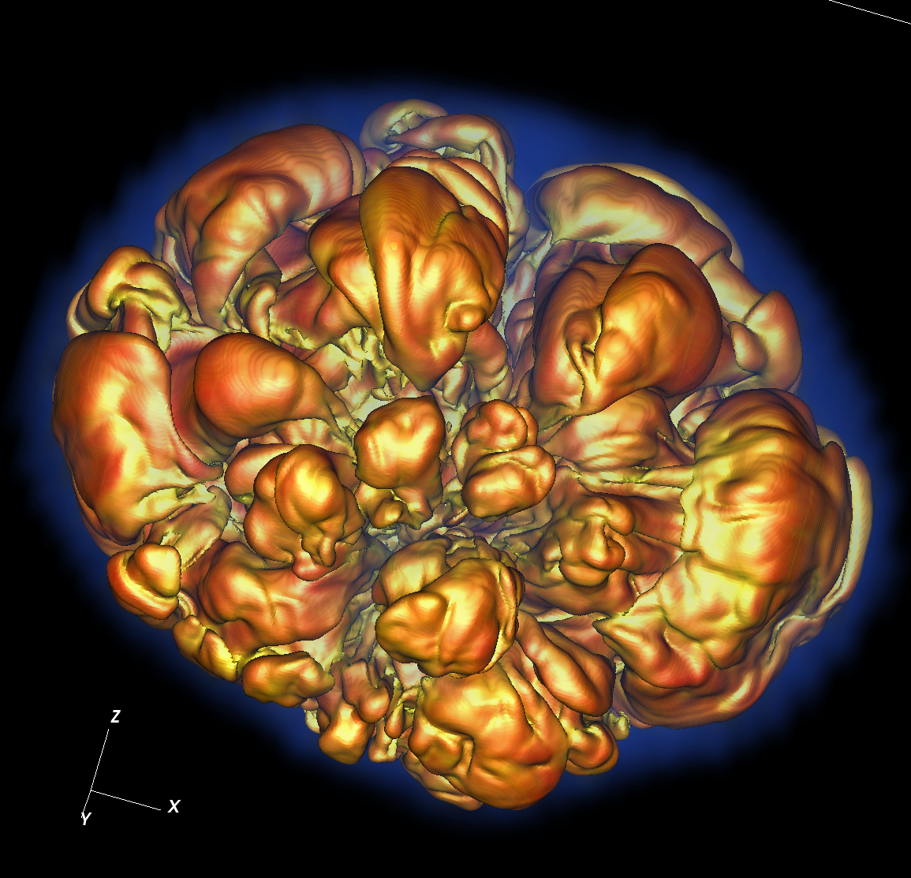
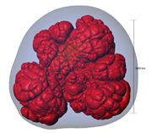
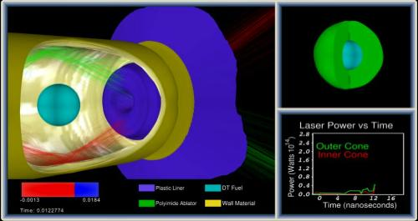
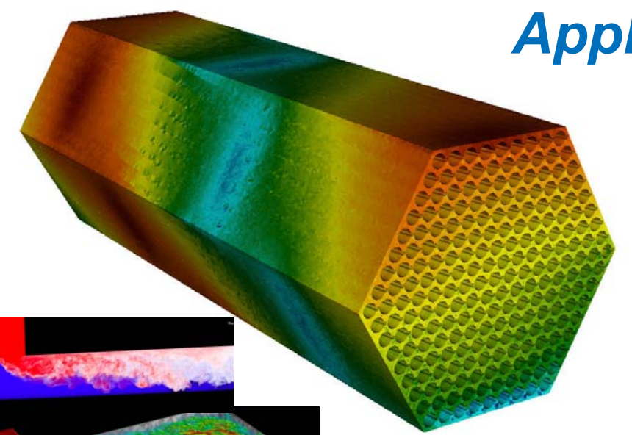
CIS 441/541: Intro to Computer Graphics Lecture 8: 1F overview, OpenGL
February 5, 2019
Hank Childs, University of Oregon

Slide 2
Office Hours: Week 5
Monday: 1-2 (Roscoe)
Tuesday: 1-2 (Roscoe)
Wednesday: 1-3 (Roscoe)
Thursday: 1130-1230 (Hank)
Friday: 1130-1230 (Roscoe)

Slide 3
Timeline (1/2)
1E: assigned Thurs Jan 31st, due Weds Feb 6th
→ will be extra support with this. Tough project.
1F: assigned Feb 7th (Feb 1), due Feb 19th
→ shading is easier than camera, but: movie
2A: posted now, due Feb 21st
→ you need to work on both 1F and 2A during Week 6 (Feb 11-15)
2B: posted now, due Feb 27th
YouTube lectures for Feb 12th and 14th

Slide 4
Timeline (2/2)
Sun | Mon | Tues | Weds | Thurs | Fri | Sat
Feb 3 | Feb 4 | Feb 5 Lec 8 | Feb 6 1E due | Feb 7 Begin 1F, begin 2A | Feb 8 | Feb 9
Feb 10 | Feb 11 | YouTube | Feb 13 | YouTube?? | Feb 15 | Feb 16
Feb 17 | Feb 18 | Feb 19 1F due | Feb 20 | Feb 21 2A due, begin 2B | Feb 22 | Feb 23

Slide 5
Comparing to previous terms (1/3)
Way ahead on lecture
If I complete today’s lecture, we will be 1.5 lectures ahead of the pace from previous term
Why?:
YouTube videos saving on material repeat
Bad materials in previous terms, and then have to waste class time fixing things
May only need 1 YouTube lecture from Japan

Slide 6
Comparing to previous terms (2/3)
A little behind on project pace
The W19 plan only works if you pursue *both* 1F and 2A during Week 6!
Project | Due date (F16) | Due date (W19)
1E | Monday of Week 5 | Weds of Week 5
1F | Monday of Week 6 | Tuesday of Week 7
2A | Monday of Week 7 | Thursday of Week 7
2B | Monday of Week 8 | Wednesday of Week 8

Slide 7
Comparing to previous terms (3/3)
Grading way ahead of previous terms
Solved a lot of issues & happy about this
1E,1F,2A,2B: not quite as prompt

Slide 8
Midterm
Date still not set
Considering different plan: 25 & 5

Slide 9
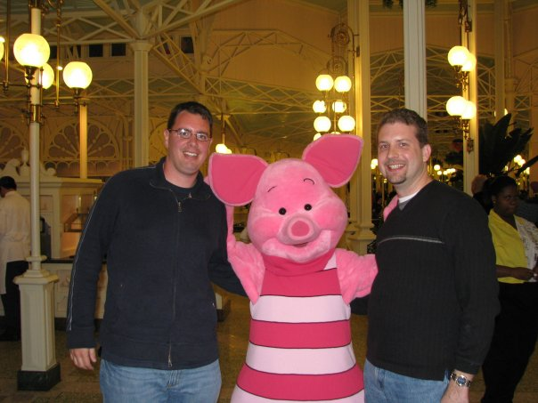
Asking good questions: my own experience

Slide 10
(start recording)

Slide 11
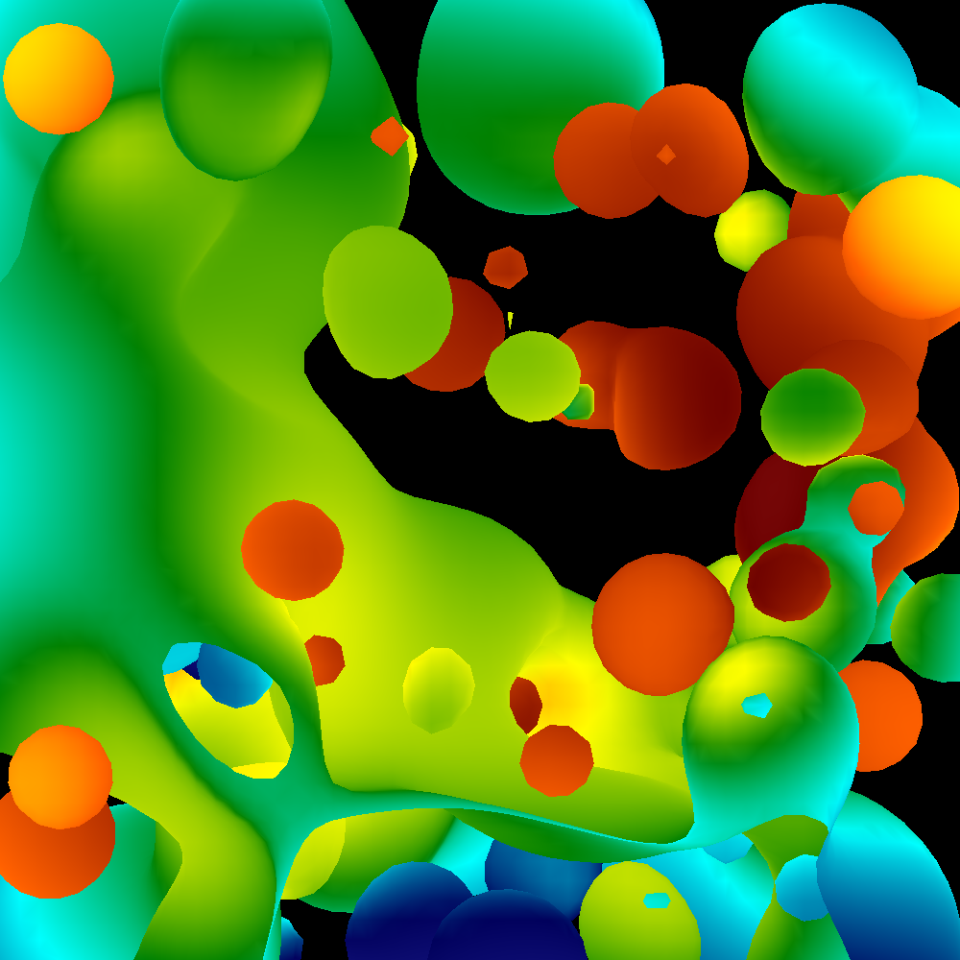
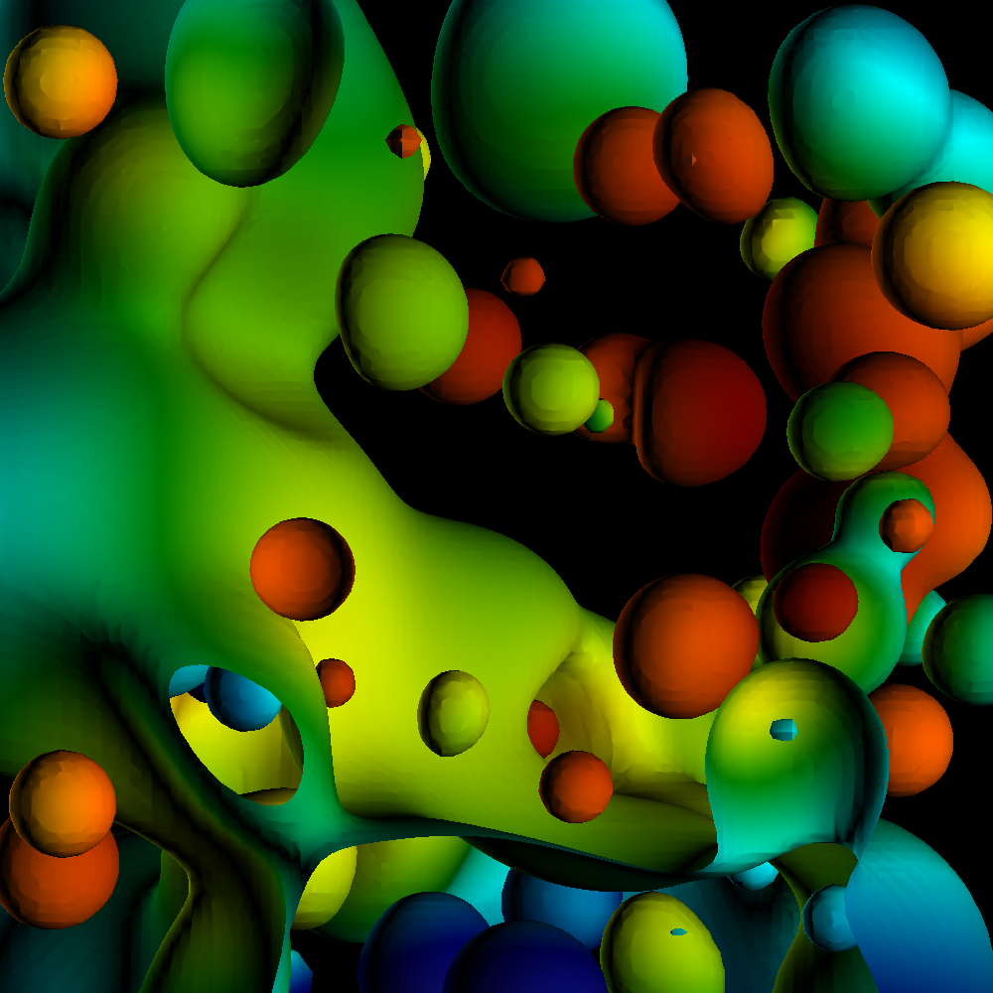
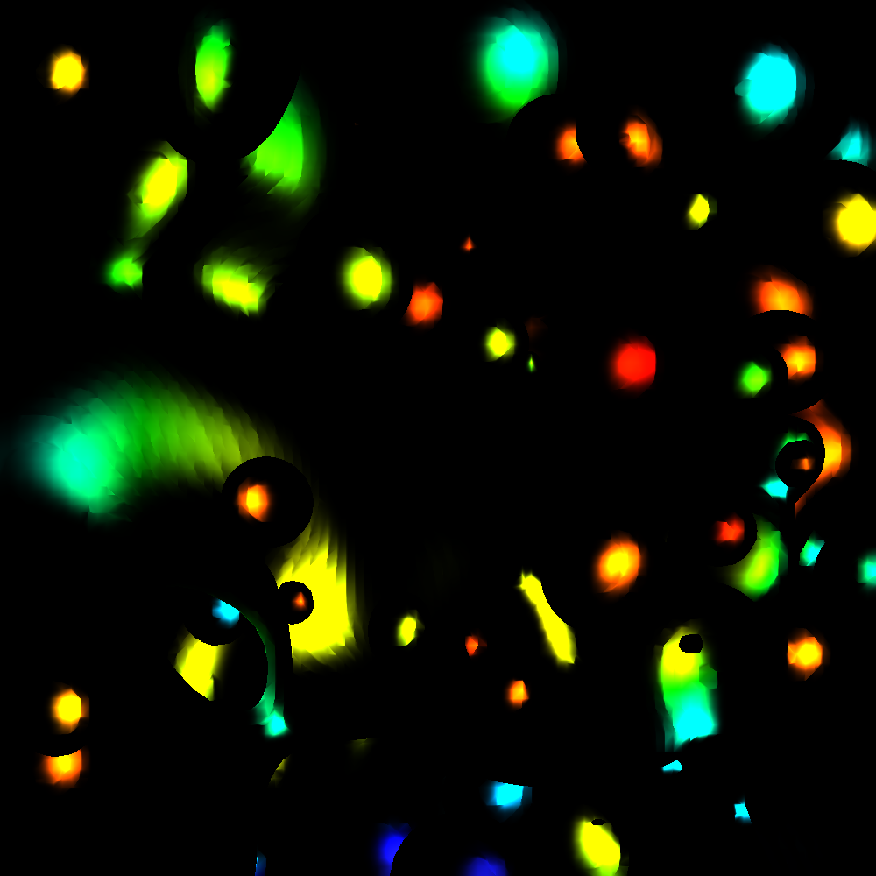
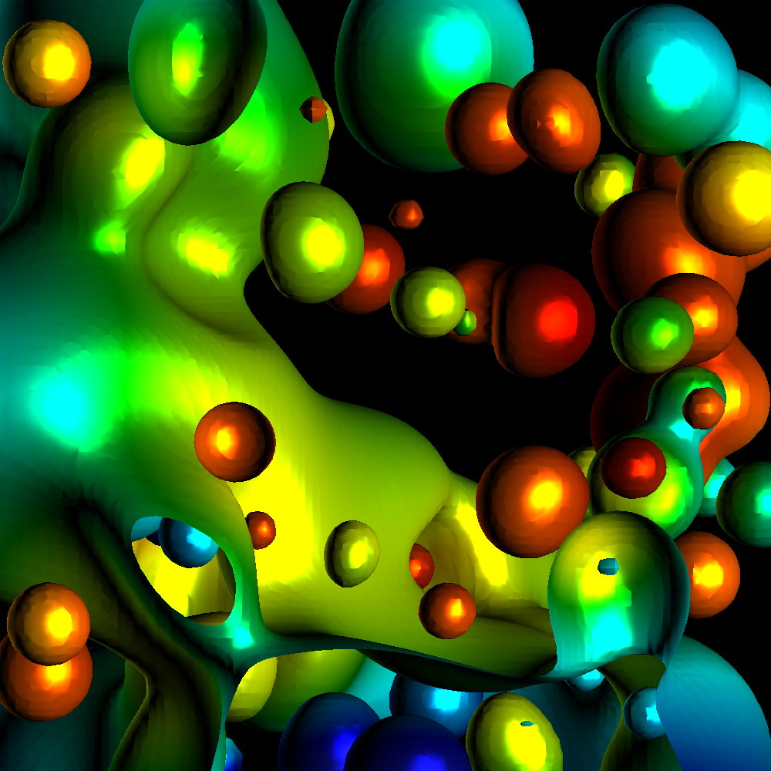
Phong Model
Combine three lighting effects: ambient, diffuse, specular

Slide 12
Phong Model
Simple version: 1 light, with “full intensity” (i.e., don’t add an intensity term)
Phong model
Shading_Amount = K_{a} + K_{d}*Diffuse + K_{s}*Specular
Signature:
double CalculatePhongShading(LightingParameters &, double *viewDirection, double *normal)
Will have to calculate viewDirection for each pixel!

Slide 13
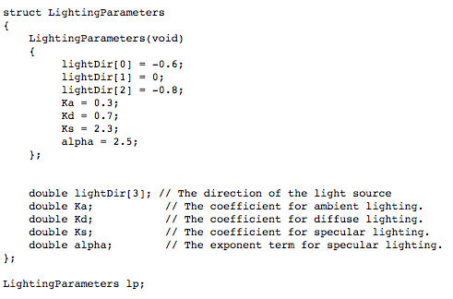
Lighting parameters

Slide 14
Project #1F (8%), Due Feb 19th
Goal: add shading, movie
Extend your project1E code
Important:
add #define NORMALS

Slide 15
Changes to data structures
class Triangle
{
public:
double X[3], Y[3], Z[3];
double colors[3][3];
double normals[3][3];
};
reader1e.cxx::GetTriangles() will not compile (with #define NORMALS) until you make these changes
Now initializes normals at each vertex

Slide 16
More comments (1/3)
This project in a nutshell:
Add method called “CalculateShading”.
My version of CalculateShading is about ten lines of code.
Call CalculateShading for each vertex
This is a new field, which you will LERP.
Modify RGB calculation to use shading.

Slide 17
More comments (2/3)
Data to help debug
I will make the shading value for each pixel available.
I will also make it available for ambient, diffuse, specular.
Don’t forget to do two-sided lighting for diffuse, one-sided lighting for specular

Slide 18
More comments (3/3)
I haven’t said anything about movie encoders
ffmpeg

Slide 19
Where Hank spent his debugging time…
Concave surface
Convex surface
Lighting direction
Lighting direction

Slide 20
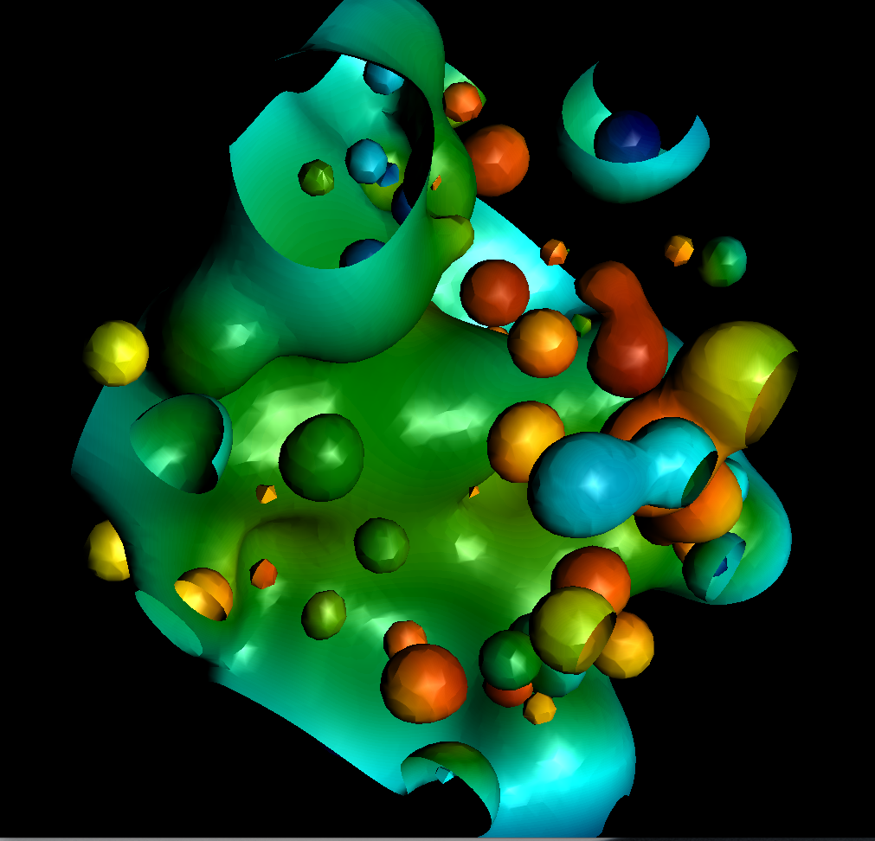
Where Hank spent his debugging time…

Slide 21
(end recording)

Slide 22
Some notes about OpenGL
OpenGL has evolved a lot over 25+ years
The slides that follow and the homeworks will detail an early version of OpenGL (OpenGL V1.0)
This is the easiest version to understand and implement
It is also inefficient
Since efficiency is important, newer versions are more complex and also faster
Optional final projects (developed by Roscoe) will let you play with this

Slide 23
OOPS
Problem! (big one)
VTK8 does not work with OpenGL1
And learning OpenGL3 would require weeks of time
So we have to roll back to VTK6
I am very sorry for this
IMPORTANT: I installed VTK6 in Room 100. You can use that for 2A/2B if you don’t want to install again.

Slide 24
Models and Architectures
Ed Angel
Professor of Computer Science, Electrical and Computer Engineering, and Media Arts
University of New Mexico

Slide 25
Objectives
Learn the basic design of a graphics system
Introduce pipeline architecture
Examine software components for an interactive graphics system

Slide 26
Image Formation Revisited
Can we mimic the synthetic camera model to design graphics hardware software?
Application Programmer Interface (API)
Need only specify
Objects
Materials
Viewer
Lights
But how is the API implemented?

Slide 27
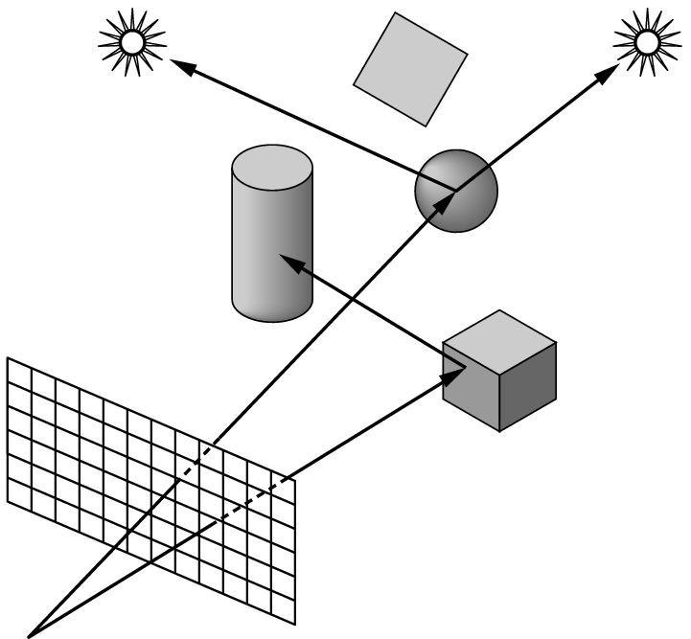
Physical Approaches
Ray tracing: follow rays of light from center of projection until they either are absorbed by objects or go off to infinity
Can handle global effects
Multiple reflections
Translucent objects
Slow
Must have whole data base
available at all times
Radiosity: Energy based approach
Very slow

Slide 28
Practical Approach
Process objects one at a time in the order they are generated by the application
Can consider only local lighting
Pipeline architecture
All steps can be implemented in hardware on the graphics card
application
program
display

Slide 29
Vertex Processing
Much of the work in the pipeline is in converting object representations from one coordinate system to another
Object coordinates
Camera (eye) coordinates
Screen coordinates
Every change of coordinates is equivalent to a matrix transformation
Vertex processor also computes vertex colors

Slide 30
Projection
Projection is the process that combines the 3D viewer with the 3D objects to produce the 2D image
Perspective projections: all projectors meet at the center of projection
Parallel projection: projectors are parallel, center of projection is replaced by a direction of projection

Slide 31
Primitive Assembly
Vertices must be collected into geometric objects before clipping and rasterization can take place
Line segments
Polygons
Curves and surfaces

Slide 32
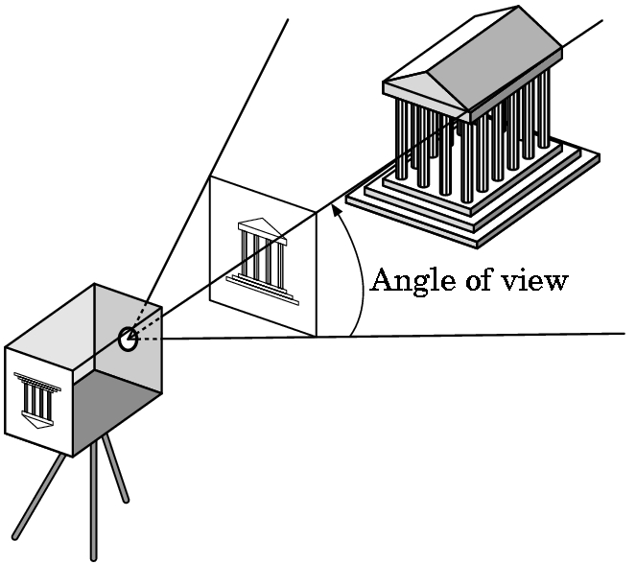
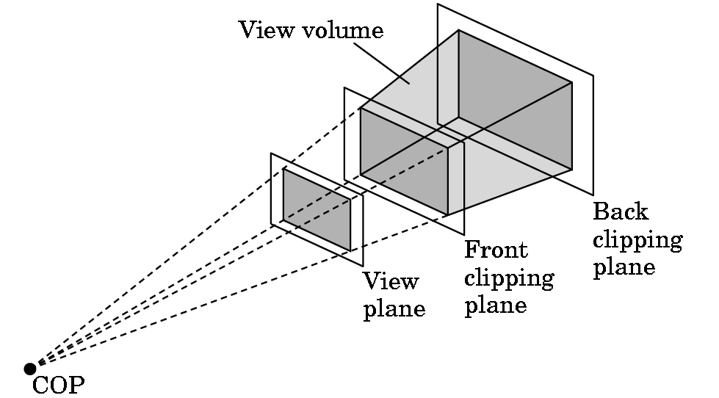
Clipping
Just as a real camera cannot “see” the whole world, the virtual camera can only see part of the world or object space
Objects that are not within this volume are said to be clipped out of the scene

Slide 33
Rasterization
If an object is not clipped out, the appropriate pixels in the frame buffer must be assigned colors
Rasterizer produces a set of fragments for each object
Fragments are “potential pixels”
Have a location in frame bufffer
Color and depth attributes
Vertex attributes are interpolated over objects by the rasterizer

Slide 34
Fragment Processing
Fragments are processed to determine the color of the corresponding pixel in the frame buffer
Colors can be determined by texture mapping or interpolation of vertex colors
Fragments may be blocked by other fragments closer to the camera
Hidden-surface removal

Slide 35
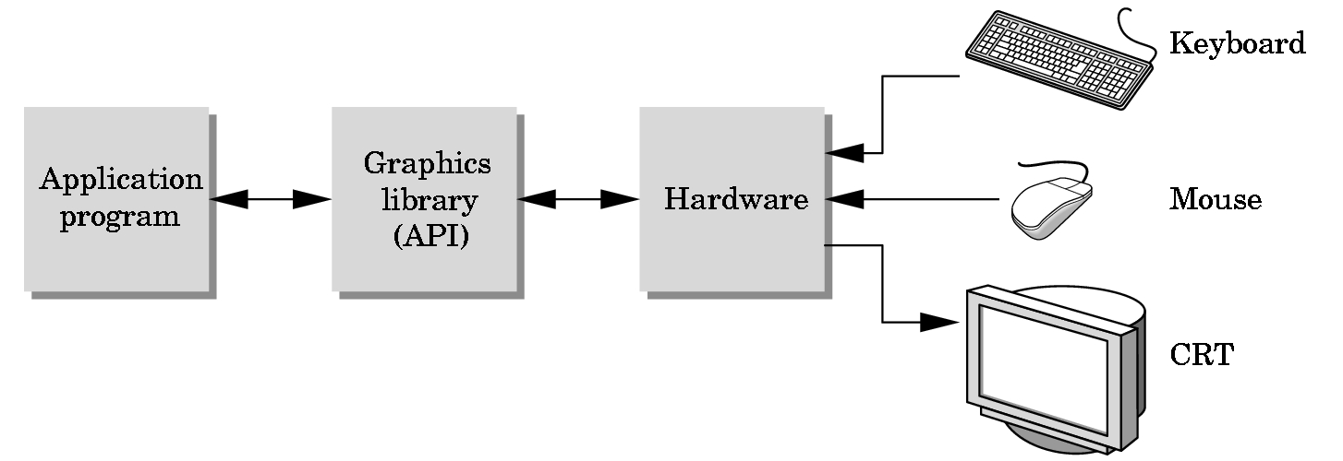
The Programmer’s Interface
Programmer sees the graphics system through a software interface: the Application Programmer Interface (API)

Slide 36
API Contents
Functions that specify what we need to form an image
Objects
Viewer
Light Source(s)
Materials
Other information
Input from devices such as mouse and keyboard
Capabilities of system

Slide 37
Object Specification
Most APIs support a limited set of primitives including
Points (0D object)
Line segments (1D objects)
Polygons (2D objects)
Some curves and surfaces
Quadrics
Parametric polynomials
All are defined through locations in space or vertices

Slide 38
Example
type of object
location of vertex
glBegin(GL_POLYGON);
glVertex3f(0.0, 0.0, 0.0);
glVertex3f(0.0, 1.0, 0.0);
glVertex3f(0.0, 0.0, 1.0);
glEnd( );
end of object definition

Slide 39
Lights and Materials
Types of lights
Point sources vs distributed sources
Spot lights
Near and far sources
Color properties
Material properties
Absorption: color properties
Scattering
Diffuse
Specular

Slide 40
Programming with OpenGL Part 1: Background
Ed Angel
Professor of Computer Science, Electrical and Computer Engineering, and Media Arts
University of New Mexico

Slide 41
Objectives
Development of the OpenGL API
OpenGL Architecture
OpenGL as a state machine
Functions
Types
Formats
Simple program

Slide 42
Early Graphics APIs
IFIPS
FKS
PHIGS

Slide 43
SGI and GL
Silicon Graphics (SGI) revolutionized the graphics workstation by implementing the pipeline in hardware (1982)
To access the system, application programmers used a library called GL
With GL, it was relatively simple to program three dimensional interactive applications

Slide 44
OpenGL
The success of GL lead to OpenGL (1992), a platform-independent API that was
Easy to use
Close enough to the hardware to get excellent performance
Focus on rendering
Omitted windowing and input to avoid window system dependencies

Slide 45
OpenGL Evolution
Originally controlled by an Architectural Review Board (ARB)
Members included SGI, Microsoft, Nvidia, HP, 3DLabs, IBM,…….
Relatively stable
Evolution reflects new hardware capabilities
3D texture mapping and texture objects
Vertex programs
Allows for platform specific features through extensions
ARB replaced by Kronos

Slide 46
OpenGL Libraries
OpenGL core library
OpenGL32 on Windows
GL on most unix/linux systems (libGL.a)
OpenGL Utility Library (GLU)
Provides functionality in OpenGL core but avoids having to rewrite code
Links with window system
GLX for X window systems
WGL for Windows
AGL for Macintosh

Slide 47
GLUT
OpenGL Utility Toolkit (GLUT)
Provides functionality common to all window systems
Open a window
Get input from mouse and keyboard
Menus
Event-driven
Code is portable but GLUT lacks the functionality of a good toolkit for a specific platform
No slide bars
<GLUT no longer well maintained, we will use VTK>

Slide 48
OpenGL Architecture
geometry
pipeline
Immediate Mode
Per Vertex
Operations &
Primitive
Assembly
Polynomial
Evaluator
CPU
Display List
Rasterization
Per Fragment
Operations
Frame
Buffer
Texture
Memory
Pixel
Operations

Slide 49
OpenGL Functions
Primitives
Points
Line Segments
Polygons
Attributes
Transformations
Viewing
Modeling
Control (GLUT)
Input (GLUT)
Query
} ^{VTK}

Slide 50
OpenGL State
OpenGL is a state machine
OpenGL functions are of two types
Primitive generating
Can cause output if primitive is visible
How vertices are processed and appearance of primitive are controlled by the state
State changing
Transformation functions
Attribute functions

Slide 51
Lack of Object Orientation
OpenGL is not object oriented so that there are multiple functions for a given logical function
glVertex3f
glVertex2i
glVertex3dv
Underlying storage mode is the same
Easy to create overloaded functions in C++ but issue is efficiency

Slide 52
OpenGL function format
function name
dimensions
glVertex3f(x,y,z)
belongs to GL library
x,y,z are floats
glVertex3fv(p)
p is a pointer to an array

Slide 53
OpenGL #defines
Most constants are defined in the include files gl.h, glu.h and glut.h
Note #include <GL/glut.h> should automatically include the others
Examples
glBegin(GL_POLYGON)
glClear(GL_COLOR_BUFFER_BIT)
include files also define OpenGL data types: GLfloat, GLdouble,….

Slide 54
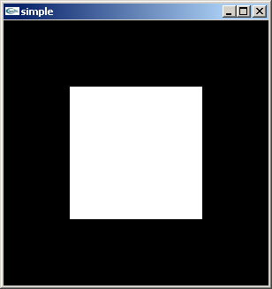
A Simple Program
Generate a square on a solid background

Slide 55
simple.c
#include <GL/glut.h>
void mydisplay(){
glClear(GL_COLOR_BUFFER_BIT);
glBegin(GL_POLYGON);
glVertex2f(-0.5, -0.5);
glVertex2f(-0.5, 0.5);
glVertex2f(0.5, 0.5);
glVertex2f(0.5, -0.5);
glEnd();
glFlush();
}
int main(int argc, char** argv){
glutCreateWindow("simple");
glutDisplayFunc(mydisplay);
glutMainLoop();
}

Slide 56
Event Loop
Note that the program defines a display callback function named mydisplay
Every glut program must have a display callback
The display callback is executed whenever OpenGL decides the display must be refreshed, for example when the window is opened
The main function ends with the program entering an event loop
VTK will be similar … callback issued to render geometry

Slide 57
Defaults
simple.c is too simple
Makes heavy use of state variable default values for
Viewing
Colors
Window parameters
Next version will make the defaults more explicit

Slide 58
How to make a graphics program?
Need to create a window
This window contains a “context” for OpenGL to render in.
Need to be able to deal with events/interactions
Need to render graphics primitives
OpenGL!

Slide 59
Windows and Events
Creating windows and dealing with events varies from platform to platform.

Slide 60
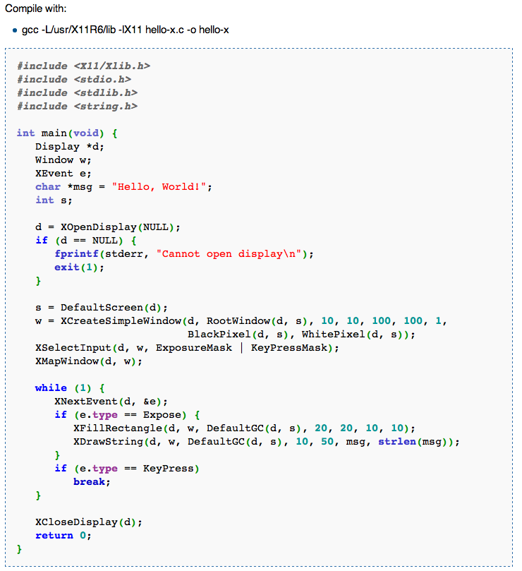
XWindow
“Hello World” with X-Windows.

Slide 61
Windows and Events
Creating windows and dealing with events varies from platform to platform.
Some packages provide implementations for key platforms (Windows, Unix, Mac) and abstractions for dealing with windows and events.
GLUT: library for cross-platform windowing & events.
My experiments: doesn’t work as well as it used to.
VTK: library for visualization
But also contains cross-platform windowing & events.

Slide 62
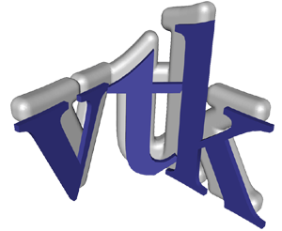
Visualization with VTK
Content from: Erik Vidholm, Univ of Uppsula, Sweden
David Gobbi, Robarts Research Institute, London, Ontario, Canada

Slide 63
VTK – The Visualization ToolKit
Open source, freely available software for 3D computer graphics, image processing, and visualization
Managed by Kitware Inc.
Use C++, Tcl/Tk, Python, Java

Slide 64
The visualization pipeline
DATA
Visualization algorithms
FILTER
MAPPING
DISPLAY
Interactive feedback

Slide 65
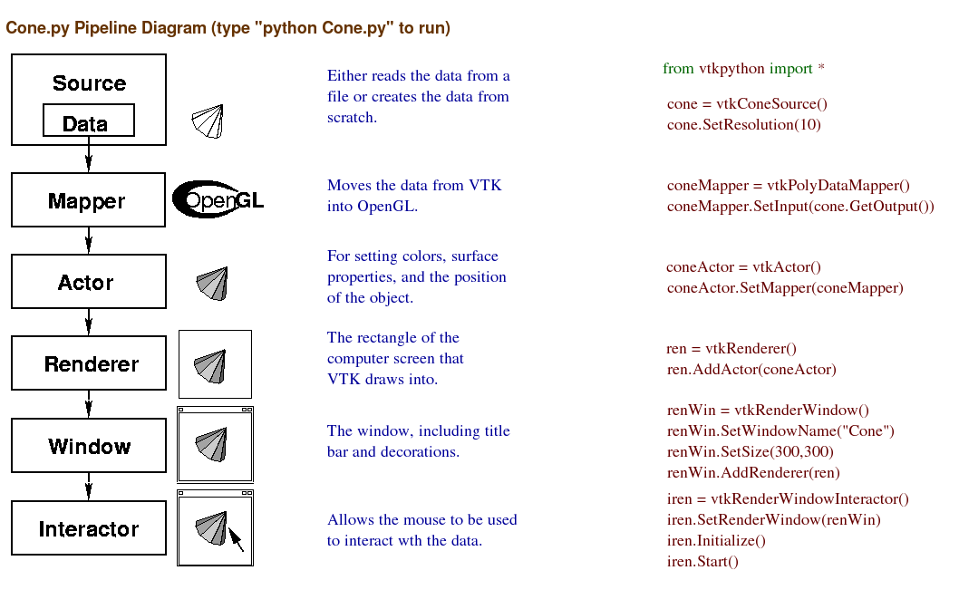
We will replace these and write our own GL calls.
We will re-use these.

Slide 66
How to make a graphics program?
Need to create a window
This window contains a “context” for OpenGL to render in.
Need to be able to deal with events/interactions
Need to render graphics primitives
OpenGL!
Borrow
Build

Slide 67
OpenGL Functions
Primitives
Points
Line Segments
Polygons
Attributes
Transformations
Viewing
Modeling
Control (VTK)
Input (VTK)
Query
Today
next week

Slide 68
First OpenGL programs
Remember: none of these programs have windowing or events
They contain just the code to put primitives on the screen, with lighting and colors.

Slide 69
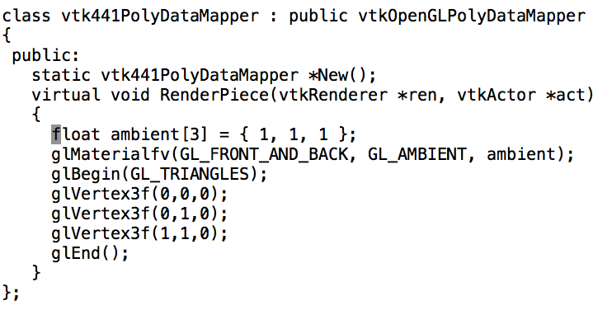

First OpenGL programs

Slide 70
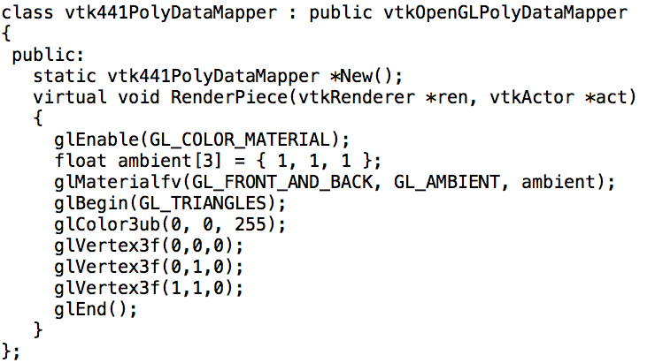
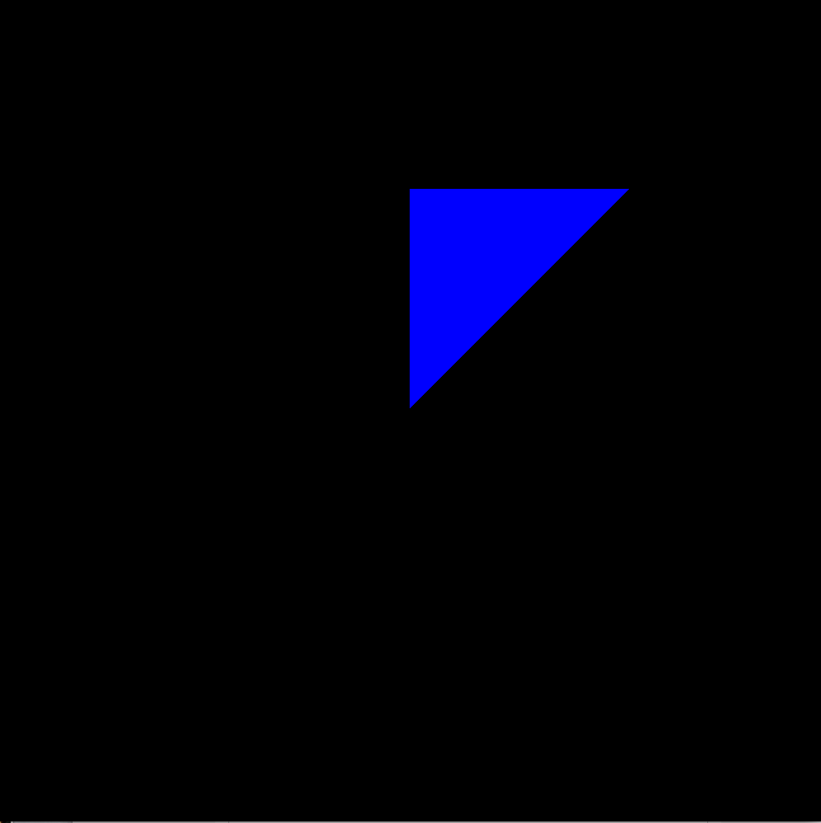
First OpenGL programs

Slide 71
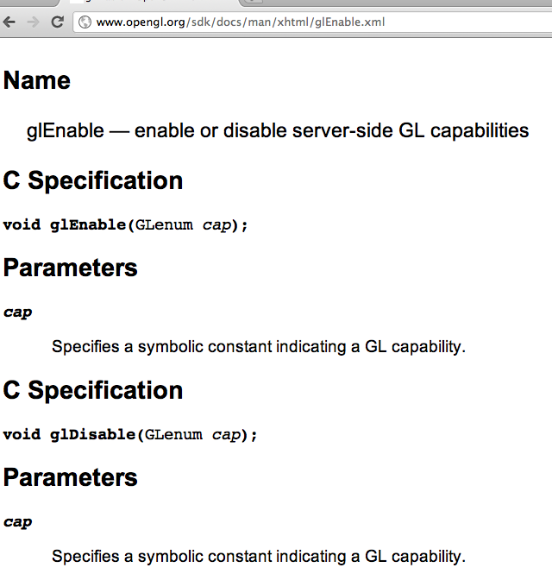
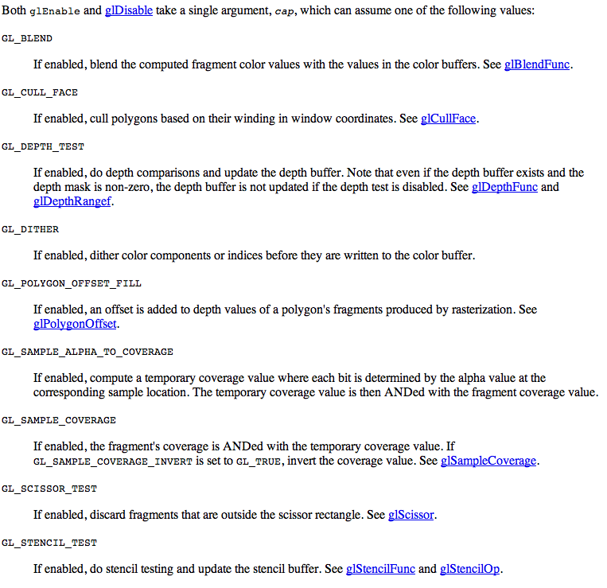
glEnable/glDisable: important functions

Slide 72
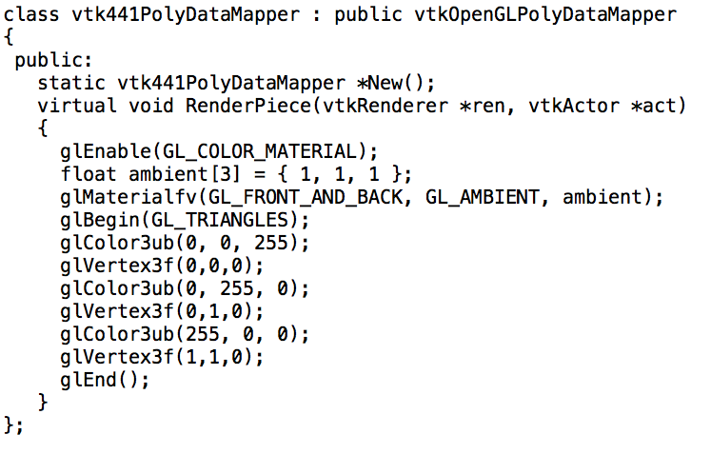
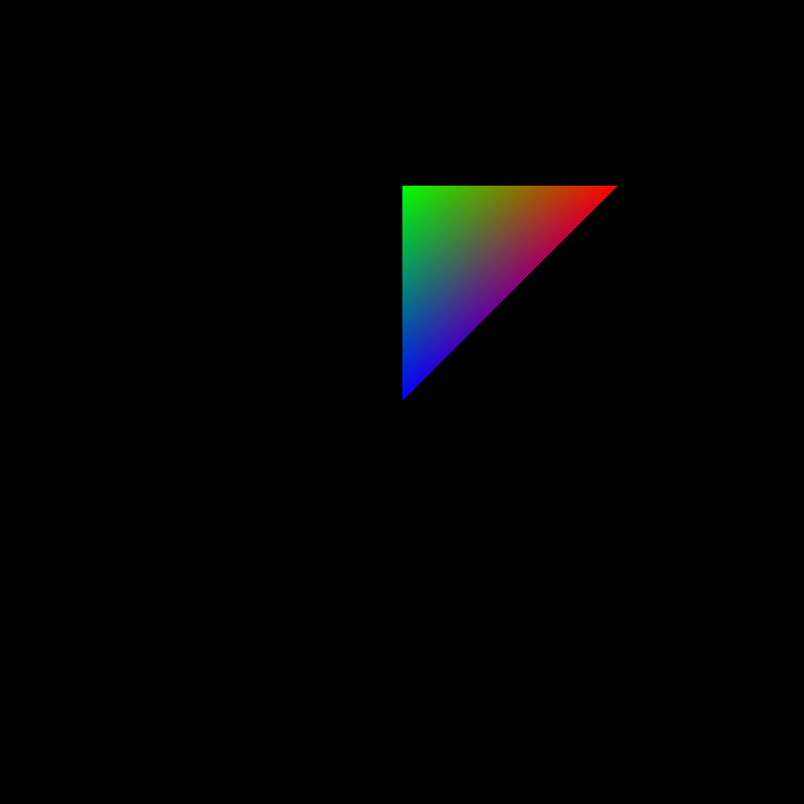
First OpenGL programs

Slide 73
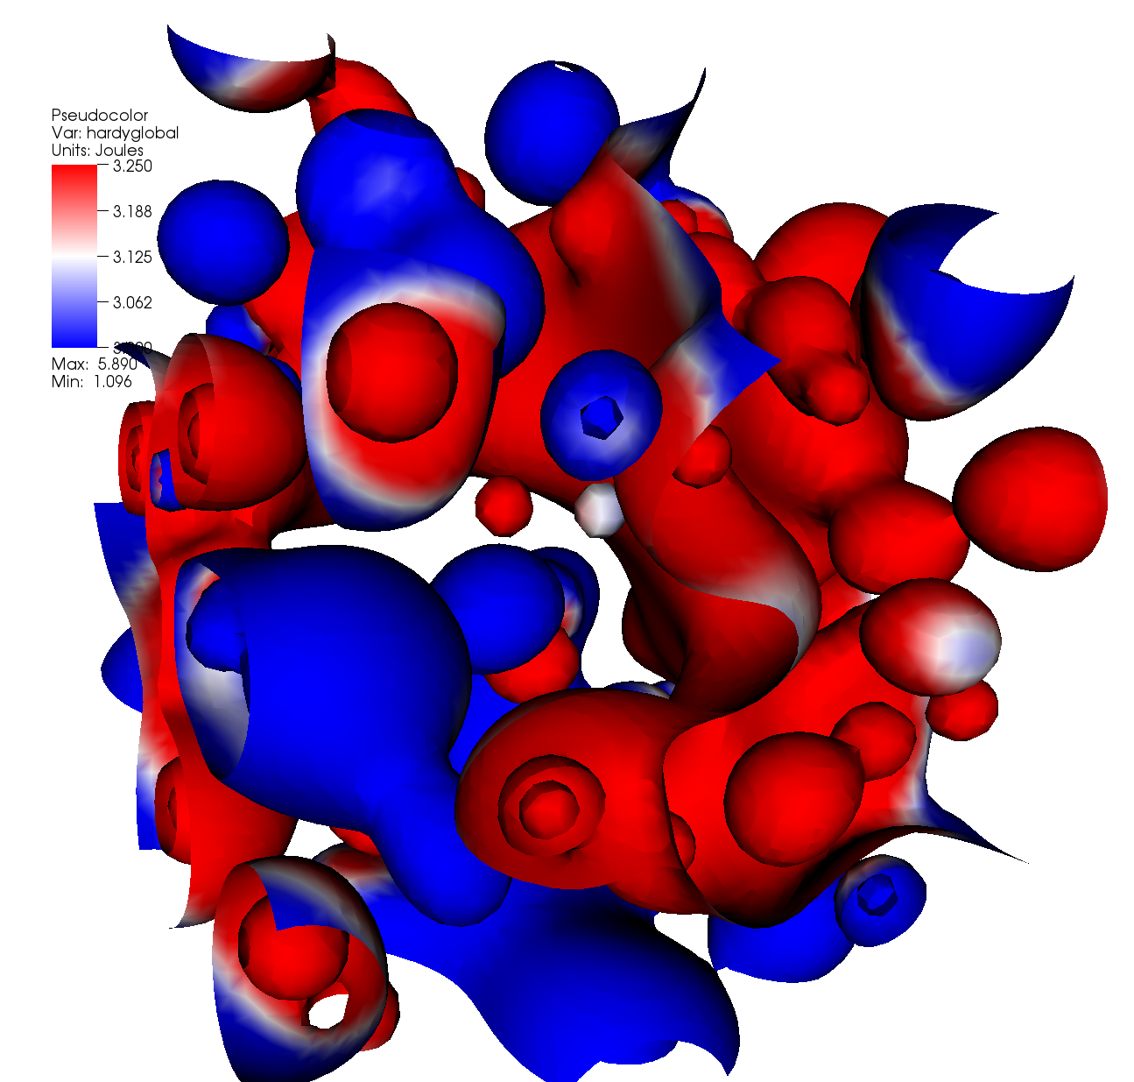
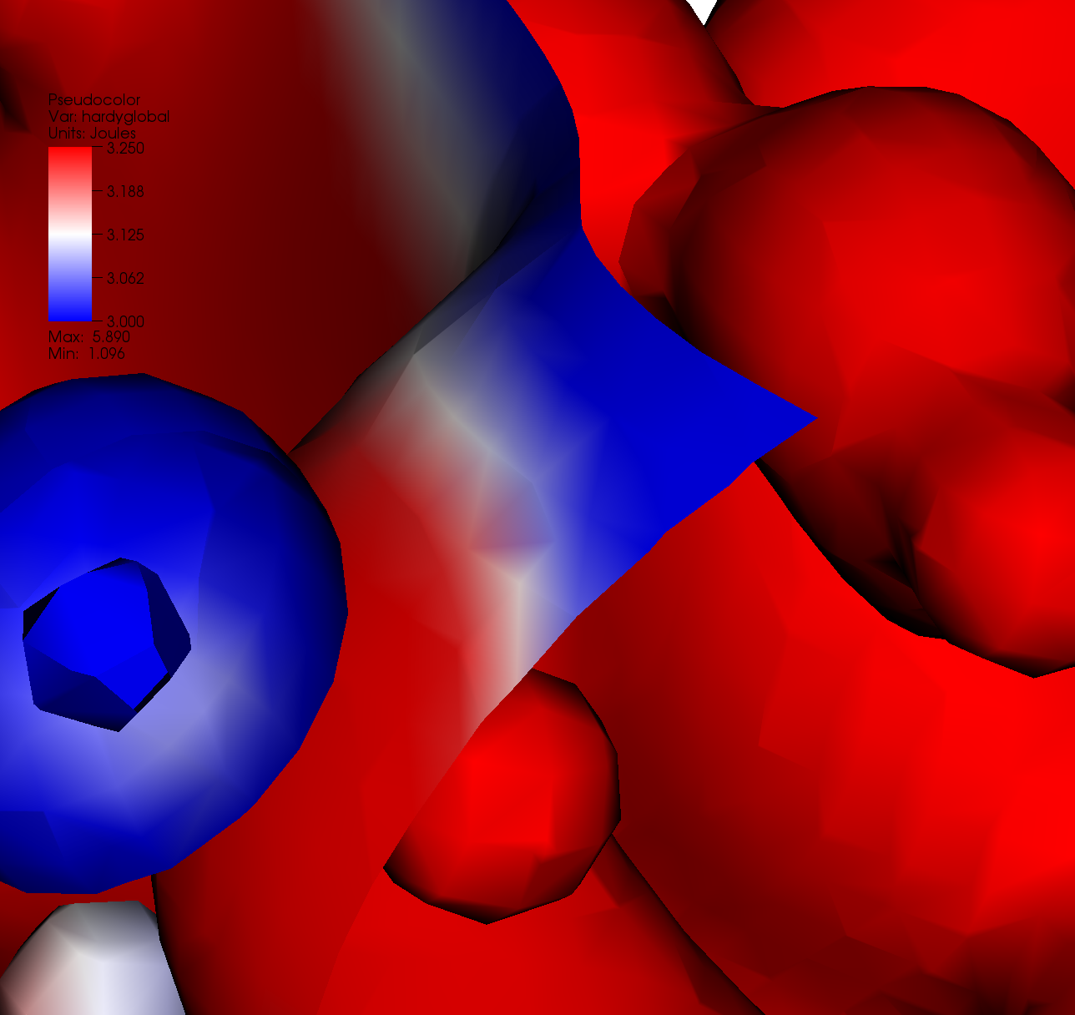
Visualization use case
Why is there purple in this picture?

Slide 74
First OpenGL programs

